Slide 1
NON TRADITIONAL MACHINING
10ME665

Slide 2
SYLLABUS
MODULE 1
Introduction
Introduction to NTM
Need for NTM
Comparison between conventional and Non conventional machining
General classification
Classification based on nature of energy employed
process selection
Advantages, Limitations and Applications

Slide 3
Machining
“It is the process of removing excess of material from the work piece to obtain the desired shape and size”
Classification
Conventional/Traditional machining process
Non Conventional/Non Traditional machining process

Slide 4
NON TRADITIONAL MACHINING
“Machining process where tool and work piece does not make contact with each other but the required machining process is done”
(or)
“Group of process that removes the excess material by various technique involving mechanical,thermal,electrical and chemical energy but do not uses sharp cutting tool “

Slide 5
Conventional/Traditional machining process
Use of hard and sharp cutting tool to remove the excess of material from work piece.
There are different type of machines designed to hold the cutting tool and perform operation
Ex:-Lathe, drilling.

Slide 6
Non Conventional/Non Traditional machining process
Process that removes excess of material by various techniques involving mechanical, thermal, electrical or chemical energy.
tool does not contact with work piece
Ex:EDM,ECM,AJM,PAM,

Slide 7
History of NTM
Need for development of NTM
Development of harder and difficult to machine material
Need to Machine complex shape
Need to avoid damage
Conventional machining are less accurate and poor surface finish
Convectional machining are not economical

Slide 8
Continued....

Slide 9
Need for Advanced Machining Processes
1. Limitations of conventional machining methods.
2. Rapid improvements in the properties of material
Metals & Non metals
Tool material hardness > work piece hardness.
3. Product requirements
Complex shapes
Machining inaccessible areas
Low tolerances
Less no of rejections
Increased repeatability
Better surface integrity
High surface finish

Slide 10
4. High production rate
5. Low cost of production
6. Precision & Ultra precision machining
(Nanometer machining- Requires material removal in the form of atoms or molecules)
7. Following cannot be done by traditional processes
- Work piece strength and hardness very high >400BHN
- Work piece material too brittle, glass, ceramics, heat treated alloys.
- Work piece too slender and flexible, hard to clamp.
- part shape complex, long and small hole.
- Special surface and dimensional tolerance requirements.

Slide 11
Classification of Nontraditional Processes by Type of Energy Used
Mechanical ‑ erosion of work material by a high velocity stream of abrasives or fluid (or both) is the typical form of mechanical action
Electrical ‑ electrochemical energy to remove material (reverse of electroplating)
Thermal – thermal energy usually applied to small portion of work surface, causing that portion to be removed by fusion and/or vaporization
Chemical – chemical etchants selectively remove material from portions of work part, while other portions are protected by a mask

Slide 12
I. Mechanical Energy Processes
It is characterized by the fact that the material removal is due to the application of mechanical energy in the form of high frequency vibrations or kinetic energy of an abrasive jet.
Ultrasonic machining
Water jet cutting
Abrasive water jet cutting
Abrasive jet machining

Slide 13
II. Electrochemical Machining Processes
Electrical energy used in combination with chemical reactions to remove material
Reverse of electroplating
Work material must be a conductor
Processes:
Electrochemical machining (ECM)
Electrochemical deburring (ECD)
Electrochemical grinding (ECG)

Slide 14
III. Thermal Energy Processes
Very high local temperatures
Material is removed by fusion or vaporization
Physical and metallurgical damage to the new work surface
In some cases, resulting finish is so poor that subsequent processing is required
[The material is removed due to controlled, localized heating of the work piece. It result into material removal by melting and evaporation.
The source of heat generation in such cases can be widely different.]
Electric discharge machining
Electric discharge wire cutting
Electron beam machining
Laser beam machining
Plasma arc machining

Slide 15
IV. Chemical Machining (CHM)
Material removal through contact with a strong chemical etchant
Processes include:
Chemical milling
Chemical blanking
Chemical engraving
Photochemical machining
All utilize the same mechanism of material removal

Slide 16
Comparison between conventional and non conventional Machining Process
Conventional Machining | Non-conventional machining
Use mechanical energy | Uses abrasive erosion, ion displacement, fusion
It is not a micro machining | It is a micro machining
Accuracy is less | Accuracy is more
High hardness cannot machining | Any hardness can machine
Metal removal rate is a more | Metal rate is less
Difficult shape cannot machined | Difficult shape can be machined

Slide 17
Conventional Machining VS NonConventional Machining
The cutting tool and work piece are always in physical contact, with a relative motion against each other, which results in friction and a significant tool wear.
In non-traditional processes, there is no physical contact between the tool and work piece. Although in some non-traditional processes tool wear exists, it rarely is a significant problem.
Material removal rate of the traditional processes is limited by the mechanical properties of the work material. Non-traditional processes easily deal with such difficult-to-cut materials like ceramics and ceramic based tool materials, fiber reinforced materials, carbides, titanium-based alloys.

Slide 18
Continue…
In traditional processes, the relative motion between the tool and work piece is typically rotary or reciprocating. Thus, the shape of the work surfaces is limited to circular or flat shapes. In spite of widely used CNC systems, machining of three-dimensional surfaces is still a difficult task. Most non-traditional processes were develop just to solve this problem.
Machining of small cavities, slits, blind or through holes is difficult with traditional processes, whereas it is a simple work for some non-traditional processes.
Traditional processes are well established, use relatively simple and inexpensive machinery and readily available cutting tools. Non-traditional processes require expensive equipment and tooling as well as skilled labor, which increases significantly the production cost.

Slide 19
Process selection
To make efficient use of modern machining process ,it is necessary to know the exact nature of the machining process
These method cannot replace conventional process.
A particular machining method found suitable for given condition may not be equally efficient for other condition.

Slide 20
Continued....
Before selecting the following must be studied
Physical parameter
Properties of the work material and shape of machined object
Process capability
Economic consideration

Slide 21
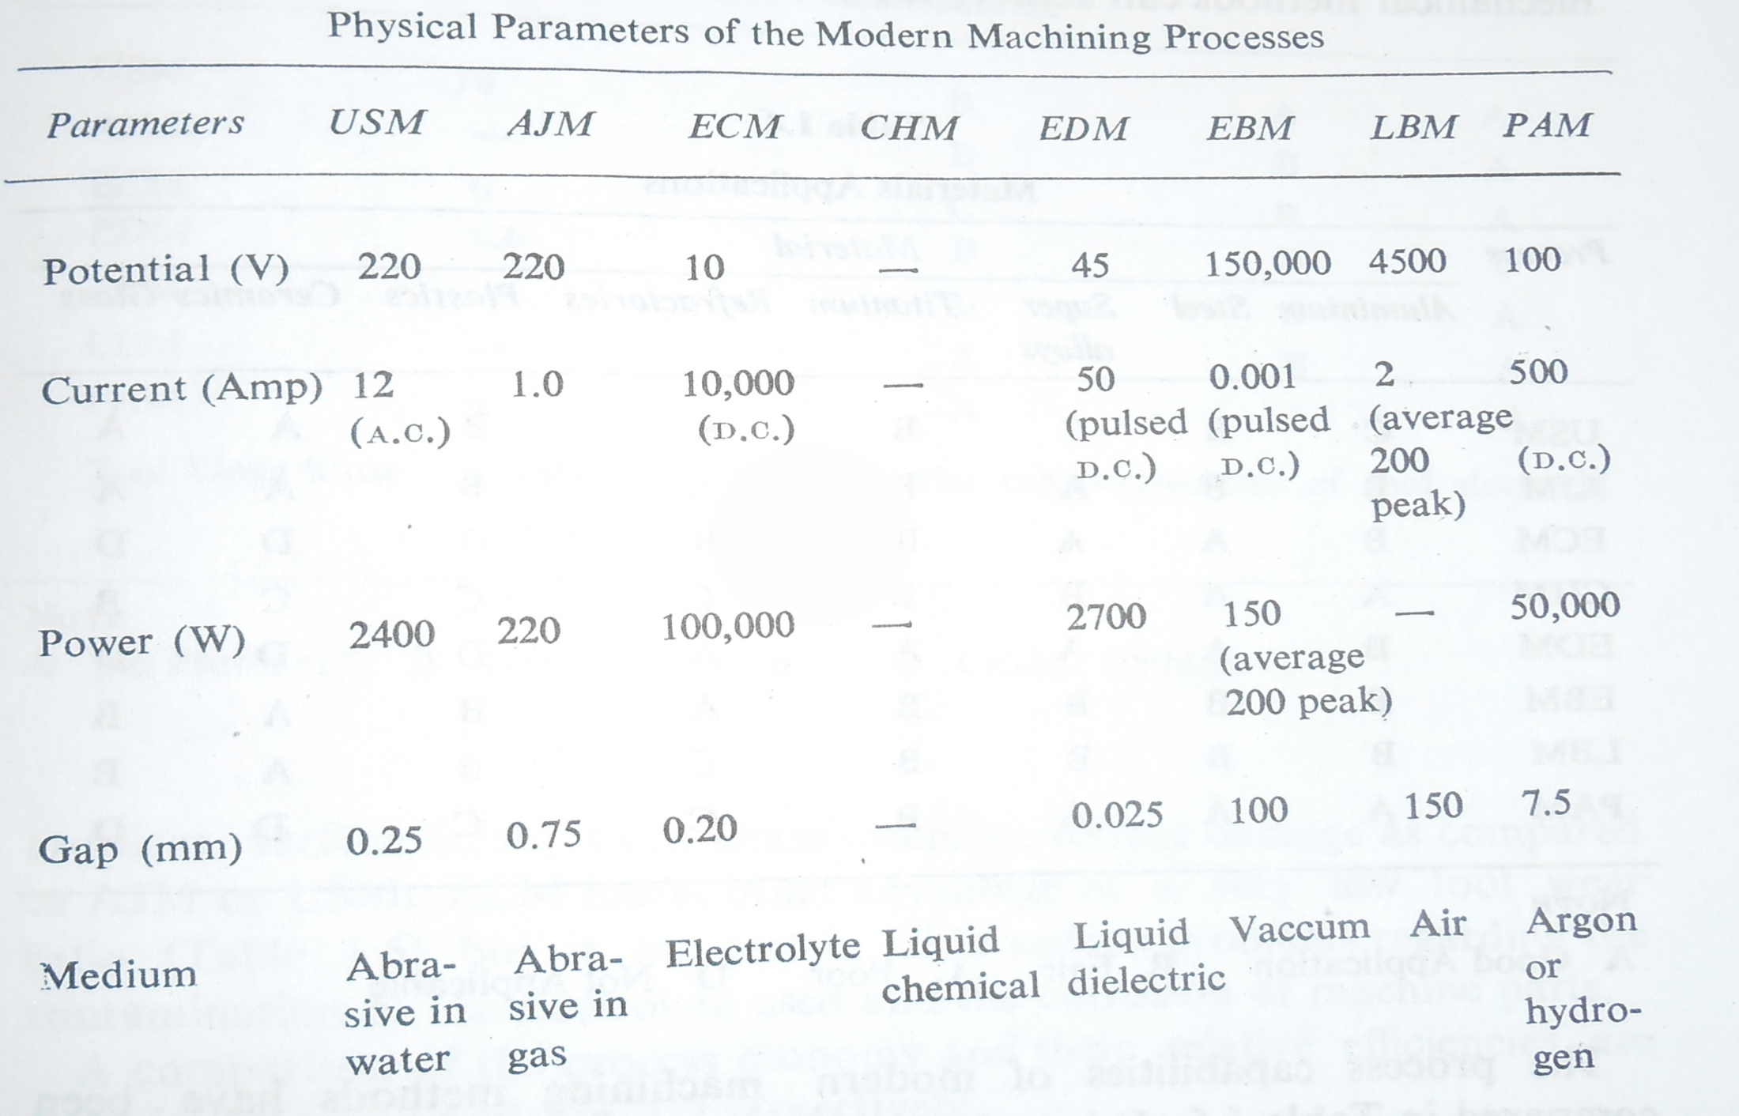
I.Physical parameter

Slide 22
II.Properties of the work material and shape of machined object

Slide 23
Continued......

Slide 24
Process capability

Slide 25
Economic consideration

Slide 26
Advantages:
Difficult to machine materials can be machined with non conventional process.
Machining materials in the complex shapes is possible with non conventional process
Economical for mass production for long duration.
High strength to weight ratio, hardness and heat resisting materials can be machined with non conventional process.
High accuracy and surface finish

Slide 27
6. Material removed without mechanical contact with the workpiece(ECM,EDM,LBM,CHM).
7. Material removal rate is independent of workpiece hardnesss(ECM,LBM,EDM)
8. Cutting forces are independent of workpiece hardness.(ECM,LBM,EDM,CHM)
9. Tool material need not be harder than the workpiece material.(ECM,LBM,EDM,CHM,USM)
10. Tool wear is not a problem(ECM,LBM,CHM)
11.Ability to machine any material.(LBM)
12. Burr-free machining(ECM,EDM,CHM)
13. Stress- free machining.(ECM,ECG,CHM)

Slide 28
14. Uniform material removal over the entire area simultaneously.(ECM,CHM)
15. Superior surface integrity possible (ECM,CHM,ECG)
16. Intricately shaped, very hard and fragile materials can be machined.(USM)
17. Finely focused micro machining
18. Micro- hole drilling at shallow entrance angles possible.(EDM,ECM,LBM,EBM)
19. Easy compatibility with numerical control and mini- computer controls.(ECM,EDM,LBM,EBM)

Slide 29
Limitations:
Work piece and tool must be electrically conductive(e.g. EDM,ECM)
Depth of cut is limited(e.g. LBM)
Recast or heat affected zones(HAZ) of surfaces produced may be troublesome(e.g. EDM,LBM,EBM)
For this purpose the compatibility of the process with the metallurgical state of the work piece materials can be studied before using a particular non-traditional machining process for production work.
There may be taper in the sidewalls of holes or cavities(e.g. EDM,LBM)
Most of these limitations can be overcome and controlled, so that the advantages can be obtained with good product quality assurance.

