Slide 1
Rao Badhur Y Mahabaleshwarappa Engineering College (RYMEC) (Formerly , Vijayanagara Engineering College (VEC), Ballari )
Welcome to 4th Semester Mechanical Engineering, RYMEC Family.

Slide 2
Metal Cutting & Forming -18ME45A
Syllabus of MCF covers basically - 2 Manufacturing Processes:
- Metal Cutting: - Metal Forming:
Module -1, Module - 2 and Module - 3 : Metal Cutting.
Module - 4 and Module – 5 : Metal Forming.

Slide 3
COURSE OUTCOMES:
At The End Of The Course The Student Will Be Able To:
CO1: Explain the construction & specification of various machine tools.
CO2: Discuss different cutting tool materials, tool nomenclature & surface finish.
CO3: Apply mechanics of machining process to evaluate machining time.
CO4: Analyze tool wear mechanisms and equations to enhance tool life and minimize machining cost.
CO5: Understand the concepts of different metal forming processes.
CO6: Apply the concepts of design of sheet metal dies to design different dies for simple sheet metal components.

Slide 4
Module 4 :MECHANICAL WORKING OF METALS
Introduction To Metal Forming
A product can be manufactured by following methods:
1. Casting.
2. Forming.
3. Joining.
4. Machining.
Forming or metal forming : process in which the desired shape and size of the component is obtained through plastic deformation of the metal.
Component formed through plastic deformation posses better mechanical properties than casting or machining.
Wastage of work material is negligible or very small.
Automotives, Pressure vessels , connecting rods (applications of forming process).

Slide 5
Classification Of Metal Forming/Working Process
Metal forming can be classified as :
1. Based On Nature Of Force Applied
2. Based On Working Temperature.
Based On Nature Of Force Applied:
1. Direct Compression Type.
2. Indirect Compression Type.
3. Tension Type Process.
4. Bending type process.
5. Shearing type process.
Based On Working Temperature
1. Hot Working
2. Cold Working
3. Warm Working

Slide 6
Direct Compression Type

Slide 7
Indirect Compression Type
In this type of process, although the primary force is tensile in nature , indirect compressive forces developed due to the reaction of the work piece with the die surface , resulting in plastic deformation of the work metal.
Metal forms under the influence of combined stress state.
Wire drawing, extrusion, deep drawing

Slide 8
Tension and Shearing Type Process
Direct tensile force is applied to the work piece during forming
Shearing forces ruptures the metal in plane of shear .

Slide 9
Bending Type Process
Involves the application of bending moments to the sheet metal work, with the help of die and punch

Slide 10
Based On Working Temperature
Hot Working:
If the working temperature of the work piece is above the recrystalization temperature but below the melting point .
Ex: Forging , Rolling , Extrusion etc
Working Temperature Range: 0.5 Tm -0.75 Tm (meting Temp of the work metal
Metals at increased temperature loses its strength and hardness, but regains ductility
This reduces the stress required to produce plastic Deformation.
it replaces microstructure with fine shaped grains from recrystalization at higher temperature
Cold Working:
If the working temperature of the work piece is at or near room temperature.
Ex: bending shearing , etc
In Cold Working although there is an increase in the strength , surface finish of the deformed metal, energy required to deform the work piece metal is very high at low temperatures.
Therefore making it necessary for powerful machine equipments ,resulting in overall cost in manufacturing.

Slide 11
Forging
Forging is the type of manufacturing process , wherein in a metal is heated to its plastic deformation state (above recrystalization temperature) and deformed to the desired shape and size by the application of compressive forces through a hammer , press, rolls.
If the compressive forces is applied manually by using specific tools, it is called hand forging, or smith forging
If the compressive forces is applied using machines ,it is called Power forging .
Most forging operations are usually carried out at hot working conditions.

Slide 12
Classification Of Forging Process
Forging process can be classified as :
1. Open Die Forging
2. Impression Die Forging.
3. Closed Die Forging.

Slide 13
Open Die Forging
It is also called as smith forging , carried out between flat dies that do not enclose the workipece.
Dies are usually flat in shape, but some may have simple contoured shape like round, concave, or convex .
Heated workipece metal is placed on a bottom die, which may be a anvil or press bed while the top die attached to a reciprocating ram strikes repeatedly to deform the workipece

Slide 14
Impression Die Forging
Impression die forging makes use of matched dies with contoured impression in each die
When two die halves close, the impressions form cavity whose shape is similar to that of the desired product.
Two die halves do not fully close with each other , instead designed with a small gap between them (flash gutter).
Here the heated workpiece is placed in the bottom die, which is attached to the anvil ,top die is attached to a reciprocating ram of the machine.
The ram falls down causing the top die to force the heated metal to fill the contours of the die.
When two dies come together for finishing step ,excess metal present will be squeezed out of the die cavities as thin ribbon(flash).

Slide 15
Closed Die Forging (flash less forging)
Closed die forging is a precision forging in which the entire volume of the work material is enclosed within the die and no material is allowed to escape from the mould.
The workpiece is deformed between two die halves which carry the impressions of the desired shape of the product.
The top die is attached to a reciprocating ram of the machine, while the bottom die is attached to anvil.
The heated workpiece is placed in the bottom die, the ram falls down causing the top die to force the heated metal to fill the contours of the die blocks.

Slide 16
ANVIL

Slide 17
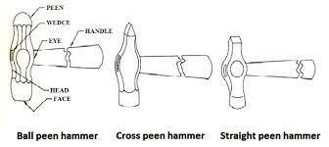
HAMMERS

Slide 18
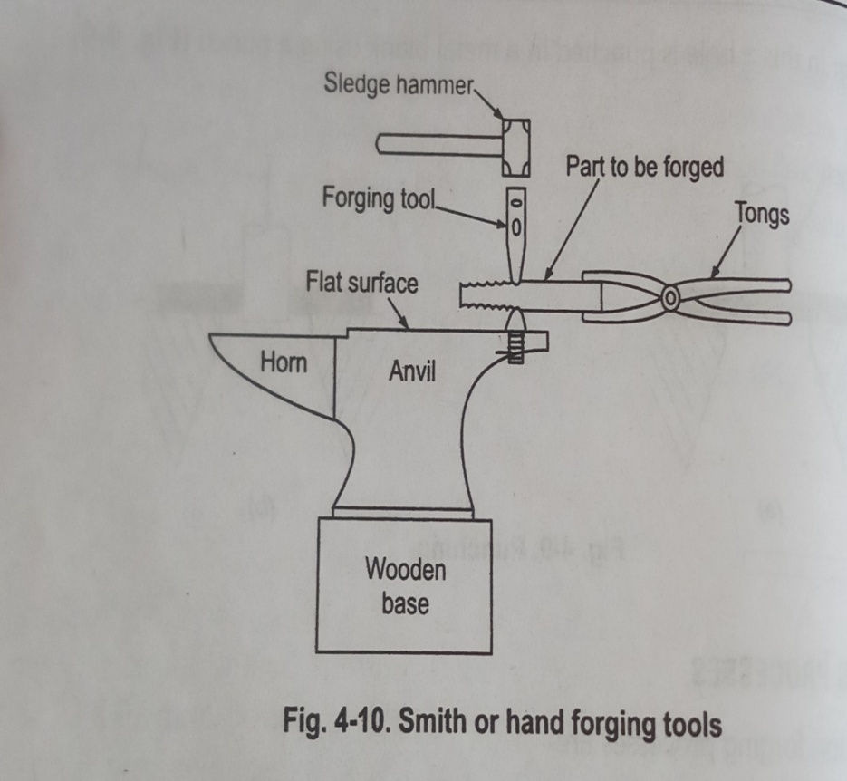
Smith forging

Slide 19
Drop Forging
It is a process where a hammer is raised and then dropped onto workpiece to deform as per required shape.
The process used closed impression dies to perform operation, these dies is used with one half attached to hammer and the other end to the anvil.
Heated metal is kept in lower cavity and strikes one or more blows with upper die.
This causes the metal to flow in several directions so as to fill die cavity and excess metal is squeezed out between die surfaces (flash).
PE = Mgh
Two types :
Gravity Drop Hammers- impact energy from falling weight of ram
Power Drop Hammers- accelerate the ram by pressurized air or steam.
Pneumatic Hammer

Slide 20
Press Forging
Here the energy is delivered through the continues squeezing action.
This causes uniform deformation through out the work.
Larger sections can be deformed.
Presses are of 150 -500 MN
Mechanical and hydraulic presses.

Slide 21
Forging Equipments
Hammers (Power Hammers)
1.Gravity drop hammers (mass)
2.Power drop hammers (Air or Steam)
3.Pneumatic hammers.
Presses (Power Presses)
Mechanical.
1. crank presses
2. Screw presses
Hydraulic presses

Slide 22
(Gravity)Board Drop Hammer
Here the upper die is attached to the ram, while lower die to the anvil.
The ram is attached to a hard wooden board, which lies between a set of mechanically driven rollers.
When foot pressure is applied and maintained on a pedal, the rollers squeeze against the board and revolve in opposite directions.
The rollers can thus raise the board and the ram due to the frictional forces between the board and the rollers.
When the board is released, the ram falls under gravity to produce the blow energy on the workpiece.
When the top die comes in contact with the workpiece, immediately the board is lifted upwards and again released to provide next blow.
The hammer continues to operate as long as the pressure on the pedal is maintained
Mass of the ram and the height of fall is fixed.
Preferred for open die forging process.

Slide 23
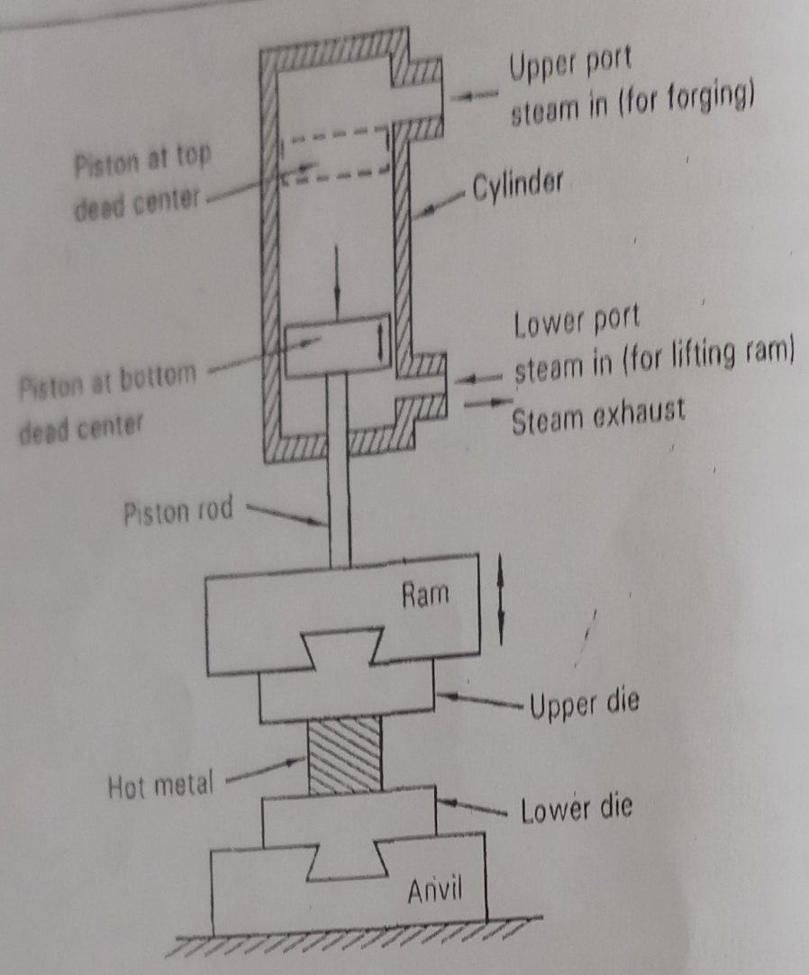
Power Drop Hammer
Initially the piston will be at the top dead center (dashed lines).Downward stroke of the ram is obtained by exhausting the steam from beneath the piston and admitting pressurized steam from above the piston (through upper port).
The ram is accelerated by the steam pressure in addition to its own weight(gravity).
The heated workpiece placed on the lower die, gets compressed b/w the die blocks.
Pressurized steam now enters through the bottom port and acts on the lower side of the piston , causing it to move upwards.
Ram is then raised to the desired height and process repeats till forging ends.
Steam pressure ranges from 6 -85 kg/Cm² .
Suitable for open and closed die forging process, intensity of blows can be varied by admitting steam through lower port, while the piston is descending.

Slide 24
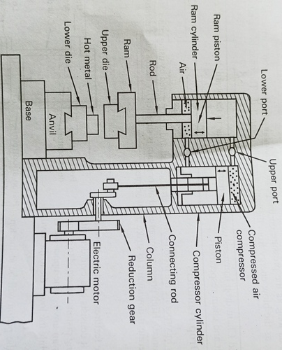
Pneumatic or Air-Lift Hammer
Consists of two cylinders(ram and compressor).
The piston in the compressor cylinder is reciprocated by means of a crank drive, which is powered from electric motor through a reducing gear.
Piston of compressor cylinder compress the air and delivers it to the ram cylinder through the upper port so that the piston in the ram cylinder gets actuated.
Resulting in downward movement of the piston in the ram cylinder, causing ram to accelerate and strike the hot metal placed in the lower die.
Piston in the compressor cylinder moves downwards compressing and pushing the air into the ram cylinder through the lower port.
Resulting in lifting the piston up in the ram cylinder causing ram and upper die to move upwards.
Air is compressed in both and upward and downward strike of the piston in the compressor cylinder.

Slide 25
Crank Press
The crank press uses a crank link attached to a drive shaft on which a large flywheel is also mounted.
Crank is connected to the connecting rod, which in turn is attached to a ram by a rotational joint.
Ram operates in a guide as shown in Fig and travels linearly while moving up and down.
The power from an electric motor causes the drive shaft and the flywheel to rotate at suitable speeds.
Crank link rotates with the drive shaft and this action causes the connection rod to convert rotary motion of the crank into reciprocating (linear) motion of the ram.
When the ram and hence the upper die moves downwards, the energy in them is used to close the mould, forming the part within.
Work is forged over a single long stroke instead a series of blows as with forging hammer.

Slide 26
Screw Press
Uses the rotational energy of a motor to turn a large screw, which in turn cause the ram and hence the upper die connected to it to move up and down.
It consists of a screw , its head connected to a large flywheel, while the tail end of the screw connected to the ram.
Frictional disc is used to translate the force from the drive shaft to the screw head.
When the flywheel is driven the rotating disc, the screw rotates and pushes the ram with great mechanical advantage.
Ram and upper die connected to it moves downwards compressing the hot workpiece against the lower die.

Slide 27
Hydraulic Presses
They derive the energy for forging through hydraulic pressure.
Fluid pressure can be increased(or decreased) by means of pump and valves.
Increased pressure is then transmitted to the ram through piston- cylinder arrangement.
It consists of large diameter ram cylinder and two small diameter lifting cylinders with corresponding pistons reciprocating in them.
Pistons are connected to a ram, to which the upper die is attached. Lower die to the press of the press bed of M/c.
Force required for forging is applied on the piston by a high pressure fluid, usually oil, supplied by pumps.
High pressure acting on the piston causes it to move downwards and hence the ram and the upper die starts advancing rapidly against the w/p placed on the lower die
w/p squeezed to fill contours of die.
Ram is now lifted up by applying the pressure of the oil on the small pistons of the lifting cylinders , when pistons reach TDC, high Pressure oil actuates the ram piston for next forging operation.

Slide 28
Forging Defects
Die Shift: Resulting from wrong alignment of the die halves, forged parts take the improper shape as a defect.
Surface Cracks: Defect on the work surface of the forged part resulting from excessive working at low Temperatures.
Overheating Defects : caused by improper heating conditions. Leads to surface oxidation and scale formation on the work surface.
Unfilled sections: occurs when metal does not fill the die cavity (improper die design)
Flakes : internal ruptures caused by improper cooling of large forged parts.

Slide 29
Introduction - Rolling
In metal working , rolling is the process of reducing the thickness or changing the cross section of a workpiece by means of compressive forces, exerted by a set of rotating rolls.
In operation, as the workpiece passes between the two constantly rotating rolls, the workpiece is subjected to high compressive stresses from the squeezing action of the rolls on the workpiece. In addition the workpiece is also subjected to surface shear stresses as a result of the friction between the rolls and the workpiece metal.
Apart from reducing the thickness of the work, rolls also act to feed the work material as they rotate in opposite directions to each other.
Rolling operations can be performed either in hot working conditions or cold working conditions.

Slide 30
TERMINOLOGIES -ROLLING

Slide 31
Classification -HOT ROLLING
In hot rolling, the workpiece is initially heated to above the recrystalization temperature and then passed between shaped rollers to obtain the desired product.
Higher Temp. helps the coarse-grained , brittle and porous structure of the ingot(cast metal) to break down into wrought structure with finer grain size.
Fine grain imparts better strength and ductility to the workpiece material.
Material must be monitored to make sure that it remains above the recrystalization temperature
If the temperature drops below the recrystalization temperature , the material must be reheated before rolling is continued.
The final finishing temperature of the workpiece is usually 50-100 (Deg-Centigre) above the recrystalization temperature.

Slide 32
Classification – COLD ROLLING
Cold rolling is usually carried out below the recrystalization temperature (at room Temp) of the work material.
The metal is compressed and squeezed, increasing the yield strength and hardness of the metal.
Cold rolling imparts desirable metal properties that cannot be obtained by hot rolling.
Good surface finish, scale-free surface, close dimensional tolerance.
However the ductility of the metal decreases due to strain hardening ,thus making the metal more brittle.
The structure changes occurred during the cold rolling consist of deformed elongated grain and in not refined condition.

Slide 33
Rolling Mills
A rolling mill is machine or factory for shaping the workpiece metal by passing through a set of rotating shaped rollers.
A rolling mills consists of rolls, bearings, a housing for containing the above parts , drive motor for applying power (Torque) to the rolls and controlling their speeds.
Commonly used rolling mills:
1. Two High Mill
2. Three High Mill.
3. Four High Mill.
4. Cluster Mill.
5. Tandem Mill.

Slide 34
Two High Mill
It is the simplest and first rolling mill used. The arrangement consists of two rolls of equal size being rotated in only one direction.
Once rolling is completed , the rolled metal has to be returned back to the entrance for subsequent reduction.
In two high reversing mill, the rotation of the rolls can be reversed. This enables the work to travel first through in one direction, and then back through in the other direction.
Thus a series of reductions can be made using the same set of rolls by passing the work back and forth.
One disadvantage, is the rolls must be stopped, reversed and then brought back to the rolling speed between each pass.

Slide 35
Three High Rolling Mill
It consists of three rolls of equal size :the upper and lower rolls are power driven, while the middle one rotates by friction.
The workpiece from the first pass, usually from the lower end is fed to the upper rolls for second pass and then back again to the lower pair of rolls for the third pass.
The rolled metal is thus passed back and forth between the lower and upper pairs of rolls thereby achieving series of reductions without the need for roll reversal or stopping.
However , such a mill must have elevating tables on both sides of the rolls for lifting and lowering the rolled metal for every pass.

Slide 36
Four High Rolling Mill
Large diameter rolls will have a larger contact work area and hence requires greater amount of roll force and energy for its operation.
This can be overcome with the use of small diameters rolls; however small diameters rolls have less strength and rigidity than large rolls and hence must be supported by back up rolls.
This uses the with two smaller work rolls, each supported by a larger back up roll.
Thin sheet can be rolled to very close tolerance with the use of small diameters rolls.

Slide 37
Cluster Mill
The diameter of back up rolls cannot be greater than 2-3 times that of the work rolls.
As the work roll diameter is decreased more and more (to accommodate process with exceedingly high rolling loads), the size of the back up rolls also decrease.
A point is reached when the back roll themselves begin to bend and must be supported; hence the design- cluster mill.
Uses small work rolls backed up by many large rolls. These types can be used for cold rolling high strength materials to a very thin cross-section.

Slide 38
Tandem Mill
In traditional rolling mill, rolling is done in several passes, but in a tandem mill, rolling is completed in a single pass.
It consists of four stands through which the work material constantly passes through.
Each set of rolls is called stands.
At each stand, the thickness of the work strip is reduced to a certain extent.
Reduction in strip size takes place successively and rolling is completed in a single pass.
One limitation, i.e.., due to reduction at each stand, the speed of the work material increases as it passes through each stand.
Hence the speed of each set of rolls must be synchronized so that each stand receives the strip at a speed equal to the delivery speed of the preceding stand.

Slide 39
Angle Of Bite Or Angle Of Contact(α)
The angle between the entrance to the rolls (entrance plane) and the centre line of the rolls as shown in Fig.
In rolling , the rolls pull the material into the roll gap by a frictional force between the workpiece and the rotating rolls.
From Fig, the horizontal component of the normal force is P_{r} sinα, and the horizontal component of the friction force F Cosα , P_{r =} Radial force acting on the work metal, F= Tangential Frictional Force acting on the work metal.
For a workipece to enter into the roll gap , the horizontal component of the frictional force which acts toward the roll gap must be equal to or greater than the horizontal component of the normal force which acts away from the roll gap. The limiting condition for unaided entry of a slab into the rolls is given by:

Slide 40
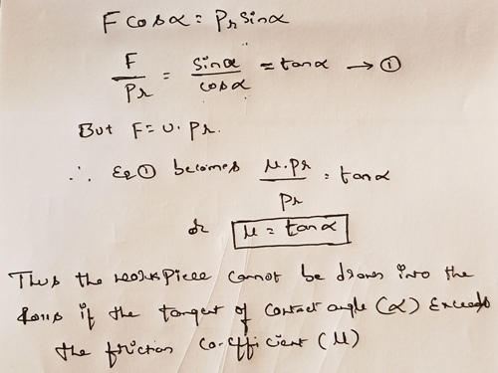
Contd….

Slide 41
Geometrical Relationships In Rolling

Slide 42
Rolling Variables
1.Roll Diameter: The roll diameter is an important factor as it directly dictates the maximum possible reduction in the work thickness. However, both rolling load and length of arc of contact of the rolls increase with increasing rolling diameter. This results in higher frictional forces leading to higher energy and power requirements. With small diameter rolls supported with suitable back-up rolls, it is possible to produce greater reduction in the thickness of the rolled product.
Friction: Larger the diameter of the roll, greater will be the contact area between the rolls and the workpiece material resulting in higher frictional forces. High friction means , high rolling load & hence more power requirements. Lubricants can be used to minimize the friction, which is separated by thin film of fluid leads to minimized friction.
Effect of Front and back Tension: Higher the applied front and back tension , lower will be the roll separating force and thinner the strip. Tensions in rolling can be applied either at the entry, designated as back tensions or at the exit , designated as front tensions.

Slide 43
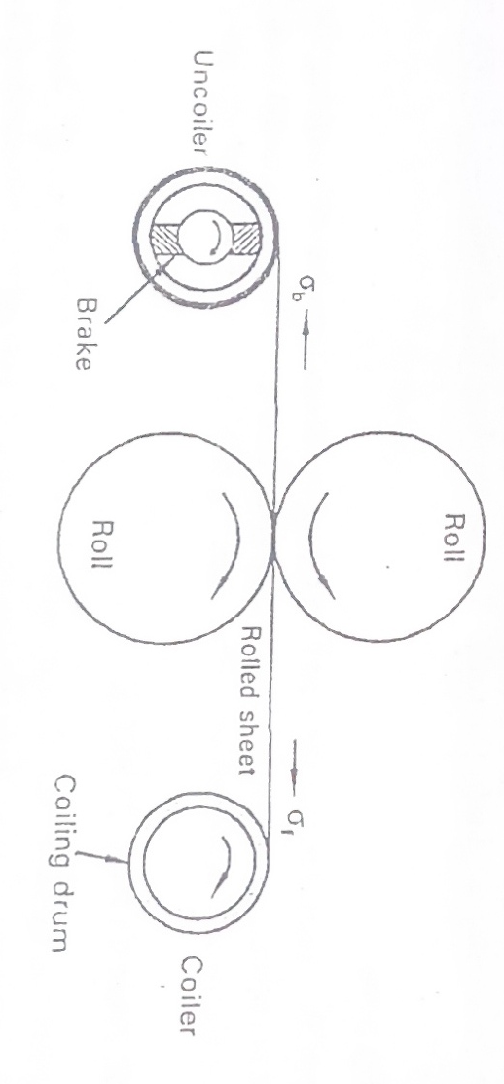
Contd….
Front tensions may be created by controlling the torque on the coiler (delivery reel) around which the rolled sheet is coiled.
While back tensions may be produced by means of a braking system in the uncoiler that controls the speed of the uncoiler relative to the roll speed.

Slide 44
Rolling Defects
Surface Defects: such as scratches, cracks. Adequate surface preparation prior to the rolling operation ca eliminate these defects.
Wavy Edges and Zipper Cracks: caused due to the bending of rolls under increased roll pressure.
Edge Crack And Center Split: These defects are caused due to inhomogeneous plastic deformation of the metal in the thickness direction.
Alligatoring : Due to friction between roll surface and the workpiece surface , the elongation on the top and bottom surface of the work is less than the deforming material at the center of workpiece thickness.

Slide 45
Introduction -Drawing Process
It is a metal forming process in which the workipece metal is pulled through a die, thereby reducing the Cross-section of the workpiece.
The shape of the die is similar to the shape of the desired product.
Drawing is used for the production of wires having diameter upto 2mm, rods, hollow tubes/pipes.
The workpiece is inserted through the die & then its end is mechanically gripped, attached to a power draw bench equipment, which pulls the workpiece through the die, thereby reducing its c/s, increasing length.
The metal undergoes plastic deformation by the combined action of applied longitudinal pull (tensile force) & pressure developed b/w work and die.

Slide 46
Drawing Die- Elements

Slide 47
Drawing Of Wires
Wire drawing is a process used to produce wires having dia up to 2mm by pulling the thick metal through a single die or through a series of dies with each successive die having small diameter than the preceding one.
The starting stock of metal is reduced in its cross-section by rolling , swaging , so as to permit it freely to enter the cavity of the die.
As the wire passes through the die, its diameter is reduced due to the compression force resulting from the reaction of the metal with die.
The exit wire is then pulled and clamped to the rotating draw block, which in turn pulls the wire continuously and winds up as shown in the Fig.

Slide 48
Drawing Of Rods
Rods have diameter greater than wires and such they cannot be coiled and hence need be drawn straight.
The draw bench equipment has a single die through which the starting stock metal is fed into the die; the reduced diameter of the rod coming out of the die is gripped tightly in the jaws of the carriage and it is pulled through a single length.
The pulling force is supplied to the carriage by means of a chain driven arrangement.
The starting stock of the metal is initially reduced in its cross section by rolling , so as to permit it freely to enter the cavity of the die.

Slide 49
Drawing Of Tubes (Pipe)
Tube drawing is a process of drawing a workpiece metal to hollow profiles, particularly hollow round tubes of different lengths, diameters and wall thickness.
The starting material for tube drawing is a hot rolled tube, which after cooling suitably reduced in Cross – Section at one of its end so as to permit the reduced portion to enter freely into the cavity of the die.
The tube after coming out of the die cavity is suitably gripped and drawing is performed on a draw bench equipment.
Hollow profiles are usually produced by inserting a mandrel ,However a tube may be formed without a mandrel also.

Slide 50
Classification: Tube Drawing Process
The Method For Drawing Tubes Can Be Done In Different Ways:
Tube Drawing without mandrel (Tube Sinking).
Tube Drawing with a fixed mandrel.
Tube Drawing with a floating mandrel.
Tube Drawing with a moving mandrel.

Slide 51
Tube Drawing Without Mandrel (Tube Sinking)
When a tube is pulled through a drawing die, without a mandrel , the process is called free tube drawing.
In operation, the tube is thoroughly cleaned and pointed out at its end so as to allow free entry into the hole of the drawing die.
The pointed end after initially passing through the die is gripped rigidly in drawing equipment.
When pulled through the die, the tube shrinks in its outer diameter to a certain value.
As the wall thickness increases, the internal surface becomes progressively rougher until cracking occurs.

Slide 52
Tube Drawing With A Fixed Mandrel
The desired internal features of the tube can be obtained with a cylindrical or conical shaped mandrel, positioned at the die land and clamped to the frame of the draw bench equipment by means of a tie rod.
The diameter of the mandrel is equal to the inner diameter of the tube being drawn.
In operation , the tube is thoroughly cleaned and pointed out at its end so as to allow free entry into the hole of the drawing die.
The pointed end after initially passing through the die is gripped rigidly in the drawing equipment, & when pulled through the annulus between the die & mandrel, the tube shrinks in its outer diameter and at the same time, the inner diameter conforming to the diameter of the mandrel.
Shaping of the inner surface of the tube commences only at the exit of the tube from the die.

Slide 53
Tube Drawing With A Floating Mandrel.
Tube drawing with a floating mandrel is used for drawing very long tubes that could not have been possible with a fixed mandrel.
Floating mandrel uses a mandrel that is not fixed , instead, is held in by the frictional forces between the mandrel and the tube.
The axial force is given by friction and pressure.
When a floating plug is used, the tube can be drawn on a bull block, from coil to coil and operation is similar to that of drawing using a fixed mandrel

Slide 54
Tube Drawing With A Moving Mandrel.
The length and the bore diameter of the moving mandrel are equal to the finished tube.
A moving mandrel adheres to the drawn tube through friction and pressure, and moves along with the drawn tube at the same velocity.
The disadvantage is, the drawn tube has to be stripped from the mandrel, which may require a further reeling process.

Slide 55
Drawing Variables- Parameters
Die Angle: For small die angles, the length of contact between the wire and the die is more , as such frictional work will be more . With larger die angles, redundant work (Ur) increases resulting in the internal distortion of the work leading to the surface defects in the drawn product. Optimum die angle must be selected which minimizes both frictional & redundant work.
Friction: In drawing, friction exists between the work & the die surface. Friction will be more for low die angles and reduces as the die angle is increased up to an optimum value.
Drawing Speed: A faster speed creates more sliding friction; the more the friction, the more is the heat generated & as a result the amount strain and stress generated increases.
Reduction In C/S Area Per Pass: In drawing , maximum reduction in C/s area per pass takes place at a point when the draw stress is equal to the yield strength of the work material. With small die angles, the drawing stress is high because of high frictional losses. With increased cone angle, friction reduces & hence higher stress can be utilized for deformation and as such reduction in area per pass will also increase

Slide 56
Introduction -Extrusion Process
Extrusion is a metal forming process in which a block of metal (or billet) is reduced in cross – section by forcing it to flow through the die of desired cross – section under high pressure.
Extrusion cab be carried out in either hot or cold conditions, however most metals are hot extruded due to large amount of forces required for extrusion.
The process begins by heating the work metal (billet) to suitable temperatures and is then loaded into the container in the press (machine).
Dummy block is placed behind the billet where the ram then presses the billet to push it out of the die.
When the pressure is applied at the closed end, the plate is forced to flow through the open end, accepting the round shape of the opening as it emerges.

Slide 57
Classification -Extrusion
Extrusion can be classified into four types:
Direct Extrusion.
Indirect Extrusion (Backward Extrusion).
Cold Or Impact Extrusion.
Hydrostatic Extrusion.

Slide 58
Direct Extrusion
Direct extrusion , also called forward extrusion is a type of extrusion process wherein the flow of metal through the die is in the same direction as the movement of ram.
During direct extrusion , metal flow and forces required are affected by the friction between the workpiece and the container walls.
So its been recommended to place a dummy block ahead of the ram.
As the extrusion proceeds the outermost surface of the work is not excluded and remains in the chamber.
This material will form thin shell called skull .
Direct extrusion finds application in the manufacture of solid bars, hollow tubes.

Slide 59
Indirect Extrusion (Backward Extrusion)
Also called as reverse extrusion, wherein the work metal flows in the direction opposite to the ram movement.
In indirect extrusion, the billet remains stationary while the die is pushed into the billet by the hollow ram through which the extrusion takes place.
The billet and the container do not experience any displacement , and hence there are no frictional forces between the work & the container walls.
Thus the force required & hence the power for extrusion is less than that required for direct extrusion.

Slide 60
Cold Or Impact Extrusion
In Impact type of extrusion process a slug or small shot of solid cold metal placed in a shallow die cavity is formed by the impact action of rapidly moving punch that forces the metal through the die, or back around the punch.
Backward type of Impact Extrusion, where the work metal flows in a direction opposite to the direction of punch.
In operation, a cold metal slug (W/p) of suitable size is placed in the die cavity (mould) and stuck by a punch with great force causing the work metal to rapidly flow into position in an instant.
Since the die is a closed part , the deformed work metal is forced upwards through the gap between the punch & the die. The gap indicates the thickness of the desired part .

Slide 61
Forward Type Extrusion
Here the work metal flows in the direction of the punch .
The result of this impact extrusion are accuracy, precision , tighter tolerance& low cost.
Tooling must have sufficient impact resistance , fatigue resistance for withstanding the heavy forces involved in the process.
It is important that the part geometry be symmetrical about the punch.

Slide 62
Hydrostatic Extrusion
Hydrostatic extrusion is a type of extrusion process in which the workpiece by the action of a liquid pressurized medium on the work metal , instead of the direct application of the load through a ram.
In hydrostatic extrusion the workpiece is held in a sealed chamber surrounded by pressurized fluid . The sealed chamber is a cylindrical shaped container that accommodates the ram(plunger), die, billet( workpiece), & pressurized fluid.
In operation, one end of the workpiece is made tapered so as to fit through the die opening thereby creating a seal for liquid leakage.
The container is filled with suitable quantity of pressurized fluid & then the ram is brought into the container to begin the extrusion process.

Slide 63
Contd…
When the plunger is forced into the container , the pressure of the fluid increases and reaches a certain value, which in turn pushes the billet through the die extruding the part.
The shape of the part is similar to the shape of the die cavity.

Slide 64
Difference Between Drawing & Extrusion
DRAWING
Here the workpiece is pulled through the die opening.
Drawing is usually carried out at room temperatures.
Drawing allows greater reduction in cross – sectional area of the workpiece.
Rods, wires, tubes are the process application of drawing.
Drawing allows cost demanding process .
EXTRUSION
Here the workpiece is pushed through the die opening.
Extrusion is usually carried out at elevated temperatures in the view of the large forces required for extrusion.
Extrusion results in smaller reduction in cross – sectional area of the workpiece.
T–shapes, L-shapes, rectangular structure are the process application of extrusion.
Beginning with cost, the extrusion process is generally a economical process.

