Slide 1
Rao Badhur Y Mahabaleshwarappa Engineering College (RYMEC) (Formerly , Vijayanagara Engineering College (VEC), Ballari )
Welcome to 4th Semester Mechanical Engineering, RYMEC Family.

Slide 2
Metal Cutting & Forming -18ME45A
Syllabus of MCF covers basically - 2 Manufacturing Processes:
- Metal Cutting: - Metal Forming:
Module -1, Module - 2 and Module - 3 : Metal Cutting.
Module - 4 and Module – 5 : Metal Forming.

Slide 3
COURSE OUTCOMES:
At The End Of The Course The Student Will Be Able To:
CO1: Explain the construction & specification of various machine tools.
CO2: Discuss different cutting tool materials, tool nomenclature & surface finish.
CO3: Apply mechanics of machining process to evaluate machining time.
CO4: Analyze tool wear mechanisms and equations to enhance tool life and minimize machining cost.
CO5: Understand the concepts of different metal forming processes.
CO6: Apply the concepts of design of sheet metal dies to design different dies for simple sheet metal components.

Slide 4
Module 1- Introduction To Metal Cutting
Metal removal process is a Machining Process in which excess amount of material is removed in the form of chips in order to shape the material to the required dimension and size.
Machining is not just one process; it is a group of processes. The common feature is the use of a cutting tool to form a chip that is removed from the work-part.
To perform the operation ,Relative motion is required between the tool and work. This relative motion is achieved in most Machining operations by means of a primary motion, called the cutting speed, and a secondary Motion, called the feed.
Shape of the tool and its penetration into the work surface, combined with these motions, produces the desired geometry of the resulting work surface.
DEPARTMENT OF MECHANICAL ENGINEERING , RYMEC, BALLARI

Slide 5
Example: Drilling A Hole
1. Rotate the drill bit or workpiece i.e.., primary or cutting motion.
2. Pressing the drill against the workpiece so that it penetrates the workpiece. i.e. ., feed motion (giving feed to drill).
In Lathe Operations:
In turning the circular cylinder on lathe the cutting motion is obtained by the rotation of the workpiece and the feed motion is obtained by the motion of the tool parallel or perpendicular to work piece axis and normal to the cutting motion.
Terminologies Or Machining Parameters :
Cutting speed (V) : It is the rate of primary cutting motion which determines the rate at which the material is being removed. It is expressed in terms of m/min.
Depth of cut: Is the thickness of metal being removed during machining. It is expressed in terms of mm.

Slide 6
Principle Operation Of Metal Cutting
With respect to the sketch, a wedge shaped edged tool is set to a certain to make a depth of cut and moves relative to the workpiece.
Under the action of force , pressure is exerted on the workpiece causing its compression near the tip of the tool. The metal undergoes shear type deformation.
If the tool is continued to move relative to the workpiece, there will be continuous shearing of the metal ahead of the tool. Shear occurs along a plane called shear plane.

Slide 7
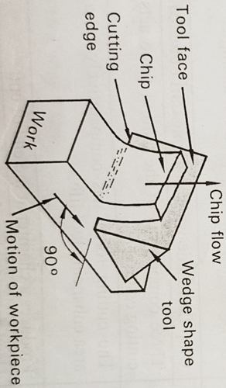
Orthogonal Cutting
Orthogonal cutting is the type of metal cutting operation in which the cutting edge of the tool is straight & perpendicular to the direction of work or tool travel.
The chip flows over the tool face ,& the direction of chip flow velocity is normal to the cutting edge.
Only two components of the cutting force acts on the tool, & both of them are perpendicular to each other & hence can be represented in a 2-D plane.
For the same feed & depth of cut, the force which shears the metal acts on a smaller are thereby reducing the life of cutting tool.
Forces developed during cutting involves only two Component (cutting force(Fc) and thrust force(Ft).
Used for parting off operation on lathe, broaching & slotting operations.
Feed direction
Cutting direction

Slide 8
Oblique Cutting
Here the cutting edge of the tool is straight & inclined to the direction of work or tool travel.
This inclination causes in the direction of the chip to flow across the tool face with a side ways movement producing a helical form of chip.
Cutting edge includes three mutually perpendicular component of force.
(Cutting force (Fc), thrust force (Ft) and radial force Fr)).
Hence it is called 3-D Cutting operation.
Here the cutting force acts comparatively on a larger area enhancing tool life.

Slide 9
Classification Of Cutting Tools
Cutting tool are used to remove any remaining material of a workpiece by clearing out excess deformity.
Classification of cutting tools: the basic classification can be done by analyzing the contact distance between tool and workpiece and number of cutting edges they possess.
Cutting Tools
Single Point Cutting Tool Multi Point Cutting Tool

Slide 10
Single Point Cutting Tool
Single point cutting tool consists of only one main cutting edge in the cutter body that can perform material removal action at a time in single pass.
Cutting edge continuously remains in contact with the workpiece.
Heat generation and rise in tool temperature will be more due to the friction and single cutting action.
Hence low feed rate and minimum depth of cut will be employed.
It can be used to perform several operations like turning , facing on lathe ,shaper machines.
Examples: turning tool, shaping tool.

Slide 11
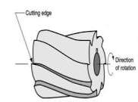
Multiple Point Cutting Tool
Multiple point cutting tools will have more than one cutting edge that simultaneously engage in cutting action in a single pass.
Multiple point cutting tool will be mounted on a machine and usually will be in rotation motion.
Forces acting on the each cutting edge will be reduced significantly.
Because of multi point action higher material removal rate (MRR).
Designing and fabrication involves difficulty because of complexity in its geometrical appearances.
Examples: milling cutter, drill tool.

Slide 12
Single Point Cutting Tool

Slide 13
Tool Nomenclature - Single Point Cutting
Tool Shank: Is the main body of the cutting tool, also part of tool is gripped in tool holder.
Face: Top surface of the tool over which the chip (cut material) flows during cutting.
Cutting Edge: is the portion of the face edge that separates the chip from the workpiece.
Side Cutting Edge (side faced of tool).
End Cutting Edge (end face of tool).
Flank : is the surface adjacent to, & below the cutting edge when the tool lies in a horizontal position.
Nose: Tip of the cutting tool, & is formed by the intersection of side cutting edge & end cutting edge.
Nose Radius: Is the radius of the nose of the cutting tool. Ranges from 0.4 to 1.6mm.

Slide 14
Cutting Tool Geometry
Side Cutting Edge: It is the angle between the side cutting edge & the longitudinal axis (Z- axis of the tool). It avoids formation of built up edge.
Side Relief Angle: Angle made by the flank of the tool & a plane perpendicular to the base just under the side cutting edge.
End Cutting Edge Angle: angle between the end cutting edge & a line perpendicular to the tool shank.
End Relief Angle: angle between a plane perpendicular to the base & the end flank of the tool.
Rake Angle: inclination of the face (top surface) of the tool with respect to the horizontal reference surface.

Slide 17
Tool signature - Single Point Cutting
Convenient Way To Specify Tool Angles By The Use Of Standardized Abbreviated System Is Called As Tool Signature.
It Is The Numerical Code That Describes All The Key Angles In The Stated Order Of The Given Cutting Tool.
It Specifies The Active Angles Of Tool Normal To The Cutting Edge.
Tool signature of single point cutting tools consists of seven elements stated in the following order.

Slide 19
Mechanics Of Orthogonal Cutting
When a cutting tool is forced to move against the rigidly held workpiece, the material of the workpiece is stressed beyond its yield point causing it to deform plastically & Shear off.
The plastic flow takes place in the localized region called shear plane.
Sheared portion of the metal begins to flow along the cutting tool face in the form of small pieces called chips.
work is done by cutting tool on the workpiece, & more than 90 % of the energy is transformed into heat.
The heat is concentrated near the tip of the tool, such as raises the temperature of the tool, the workpiece, & the shearing chips.
As a result, the workpiece & tool soften in the localized region.
In some cases, cause the chip to weld to the cutting tool (unsuitable for machining)
Hence cutting parameters, heat, wear of the tool forms basic features of cutting process.

Slide 20
CHIP FORMATION
All machining process involve formation of chips by deforming the work material on the surface of the job with the help of cutting tool.
Depending upon the tool geometry , cutting conditions and work material , a large variety of chip shapes and sizes are produced during different machining operations.
Chip formed indicates the deformation suffered by the work material and the surface quality produced during cutting.
Also Cutting fluid affects the temperature and friction at the chip-tool interface and work -tool interface.

Slide 21
MECHANICS – Chip Formation
When the cutting tool is forced to move against the workpiece, the tool exerts a compressive force on the workpiece.
The material of the workpiece is stressed beyond its yield point causing it to deform plastically and shear off.
The plastic flow take place in the localized region called Shear plane.
The sheared portion of the metal begins to flow along cutting tool face in the form a small pieces called chips as advancing tool continues to remove the workpiece metal along the shear plane.
Mechanism involves two phases:
1. Primary shear zone
2. Secondary shear zone

Slide 22
Primary Shear Zone:
As the tool is forced into the work material the chip is formed by shear deformation within a thin shear zone, calling as Primary Shear Zone.
Which is oriented at angle Ø with the surface of the work.
Failure of material due to plastic deformation occur at the cutting edge of the tool , resulting in the separation of chip from parent material.
More mechanical energy consumed here.
Thickness of shear zone will be of few thousands of an inch.
Since it is thin, we can refer as plane.

Slide 23
Secondary Shear Zone
Secondary shear action occurs in the chip after it has been formed.
This results from the friction between chip and tool as the chip slide along the rake face of the tool.
Its effect increases with increased friction between tool and chip.
This zone basically affected by
1. Type of material being deformed.
2. cutting conditions of operation.

Slide 24
Idealized Conditions Before Chip Forming
The tool is perfectly sharp and there is no contact along the flank face.
The cutting edge is a straight line perpendicular to the motion and generates a plane surface as the work moves past it.
Width of tool is greater than width of work piece.
There is no side movement of the chip in either direction.
The work piece moves with a uniform velocity related to the tool.
The stresses on the shear plane are uniformly distributed.

Slide 25
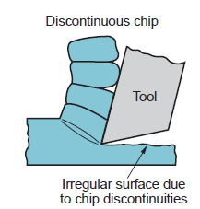
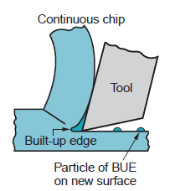
Types Of Chips

Slide 26
Continuous Chips
When a workpiece is ductile , fracture will not occur in the shear plane,, & the chips comes off in the form of a long string or ribbon like with a smooth shining surface.
Primary reason for its formation is that fact that, ductile materials has a tendency to elongate or flow much before it ruptures from the parent workpiece material.
Various conditions for Continuous Chips:
1. Workpiece Is Ductile.
2. Fine Feed & High Cutting Speeds.
3. Imparting Low Depth Of cuts.
4. Use Of Efficient Coolants.
Effects: when the chip is too long/stringy, it wraps around the tool or the workipece resulting in scratches & poor surface finish on the job. Life of cutting tools also reduces.

Slide 27
Continuous Chips with Built Up Edges (BUE)
During machining tough steels such as alloy steels , tool steels etc.,, larger cutting forces are required, in turn produces lot of heat at tool-work interface.
This causes the compresses metal adjacent to the tool nose to get welded to it in the form of Metal Lumps.
Extra metal welded to the nose or point of the cutting tool is called built up edges.
As the chip slides up the tool, a major part of the built up edge is broken & carried away along the flowing chip, while a small part of the built –up- edge adheres to the surface of the workpiece leading to poor surface finish.
Formation of BUE can be reduced by circulating a proper cutting fluid at the cutting zone during machining.
Various conditions for Continuous Chips:
1. Low Cutting Speeds.
2. Cutting Tool With Low Rake Angle.
3. Rough Surface Of Cutting Tool.

Slide 28
Effects Built Up Edges (BUE)
Formation of built up edges causes the tool edge to become blunt& lose its cutting capacity.
It unfavorably changes the rake angle at the tool tip causing increase in cutting forces & Power Consumption.
Repeated formation & dislodgement of the BUE causes fluctuation in cutting forces & thus induces vibration which is harmful for the toll , job & machine tool.

Slide 29
Discontinuous Chips or segmented chips
While cutting brittle materials like cast iron, brass, etc., the workpiece materials along the shear plane will periodically fracture producing a segmented chip.
Primary reason for the formation of such chips in brittle materials is the fact that, the binding strengths for metal grains are not very strong & as such the metal easily shears before it elongates.
Sometimes they produced while machining ductile materials, especially when low cutting speeds & adequate coolant is not supplied during cutting operation.
Resulting in poor surface finish & excessive tool wear.
Various conditions for Discontinuous Chips:
1. Workpiece material is brittle.
2. Small rake angle is provided on the tool.
3. Imparting high depth of cut.

Slide 31
Cutting Tool Materials And Its Applications

Slide 34
LATHE
LATHE is a basic machine tool which performs a number of cutting operations especially turning, threading ,drilling etc.
These are generally used for machining of cylindrical jobs.
Depending upon their characteristics function ,lathes are classified as:
1. ENGINE LATHE OR CENTER LATHE
2. Speed Lathe
3. Turret Lathe (semi automatic)
4. Capstan Lathe (semi automatic)
5. CNC Lathe
These lathes are used in practice to perform variety of machining operations depending upon requirement and scale of production.

Slide 35
ENGINE LATHE OR CENTRE LATHE OR LATHE

Slide 36
WORKING PRINCIPLE
Here the job to be machined rotates between two centers or with a chuck while one or more stationary tools performs the cutting operations.
The tool will remove the material in the form of chips from the rotating workpiece to produce circular objects.
In fig: workpiece is rigidly held in a chuck
(work holding device) and rotated at high speeds.
A v-shaped cutting tool held against the workpiece opposite to its direction of rotation , when moved parallel to the axis of the workpiece to produce circular objects.

Slide 37
PARTS OF LATHE
Support columns
Bed
Head stock (live center)
Tail stock (dead center)
Lead screw
Feed rod
Carriage
tool post
hand traversing wheel

Slide 38
LATHE ACCESSORIES
Centres (live and dead)
Chuck
Lathe dog carrier
Drive plate
Face plate
Mandrels

Slide 39
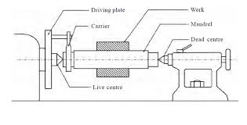
Centres (Live And Dead)
Shaft type work pieces are generally held between centres.
Conical center holes are drilled one at the end of the work piece to provide location for the lathe centres.
Live centre (revolving centre) is mounted on a ball bearing or tapered roller bearing along with thrust bearing, and rotates with the work.
Live centre is preferred during high speed machining because it reduces the frictional heat generated on the centre.
Tail stock centre may be a dead centre (stationary) which does not rotate the work , support the workpiece at the rotating end of the machine.
It produces friction between the workpiece and centre, due to the rotation of the workpiece.

Slide 40
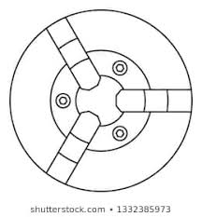
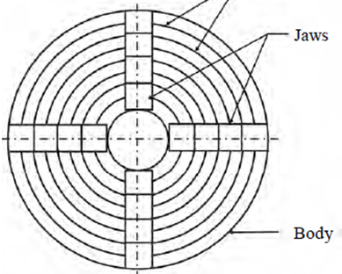
Chucks – Work Holding Devices
The jaws are made to move simultaneously and equally in radially inward outward directions by rotating disc whose spiral grooves mesh with teeths provided on the jaws.
Disc can be rotated by means of a key inserted in any one of the three sockets provided on the cylindrical surface of the chuck.
In a four jaw chuck , each of the jaws can be adjusted independently , this infact necessary for correctly aligning a non circular workpieces with the axis of spindle.

Slide 41
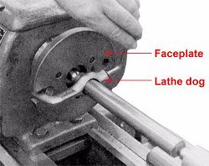
Lathe Dog Carrier
A lathe dog, also known as a lathe carrier, is a device that clamps around the workpiece and allows the rotary motion of the machine's spindle to be transmitted to the workpiece.
A lathe dog is used when you are using centers in the head stock and tail stock.
A dog is clamped to the workpiece at the head stock end, tail of the dog is inserted in a slot on the drive plate mounted on the lathe spindle.
At one end there is a loop and a setscrew. That end is slid over the work and tightened. The other end engages a slot in the face plate which drives the dog and work piece.
Most commonly used for round workpieces.

Slide 42
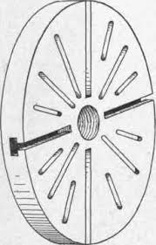
Face Plate
A lathe faceplate is a basic work holding accessory for a wood or metal turning . It is a circular metal (usually cast iron) plate which fixes to the end of the lathe spindle.
For clamping irregular shaped components face plates are used.
Its having radial slots as well as bolt holes which allow the workpiece to be clamped to it by means of bolts.
The workpiece is then clamped to the faceplate, typically using t-nuts in slots in the faceplate, or less commonly threaded holes in the faceplate itself.

Slide 43
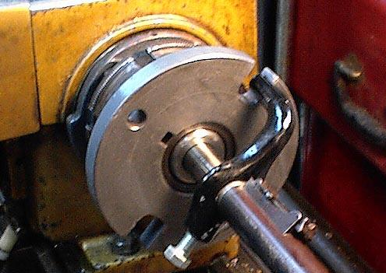
Drive Plate

Slide 44
Mandrels

